Slide 1
Fairness in Machine Learning for 2nd Order Solutions

Slide 2
Motivation
Our clients build algorithms for banks to predict who should receive financial services (e.g. loans)
Fairness in predictive algorithms mandated by law (e.g. Equal Credit Opportunity Act)
2OS would like to enhance their value proposition by adding a component to their workflow to assess and enhance fairness
Notes:
Add details about finance industry and context about ECOA, what the protected variables are and what they mean

Slide 3
Objectives
Understand fairness as it applies to financial algorithms
Find the best off-the-shelf package that assesses fairness in financial algorithms and reduces bias in those algorithms without hurting model performance.
Notes:
Add details about finance industry and context about ECOA, what the protected variables are and what they mean

Slide 4
What is fairness?
White
Non-White
All else equal, if the algorithm the bank uses gives the White person a loan, it should also give the Non-White person a loan.
Bachelor’s
Bachelor’s
Software Engineer
Software Engineer
$100k
$100k

Slide 5
How do we quantify fairness?
Disparate Impact
Measures how much less likely it is for the underprivileged group to receive a positive outcome.
Translation: How much less likely are Non-White applicants to receive approval compared to White applicants?
Notes:
First talk about what we use for dataset. The dataset is for default.
XGBoost - cliens’ preference, commonly used?
Disparate impact - include formula and explain what it is, why is it important
Compare to men, women are more likely to default

Slide 6
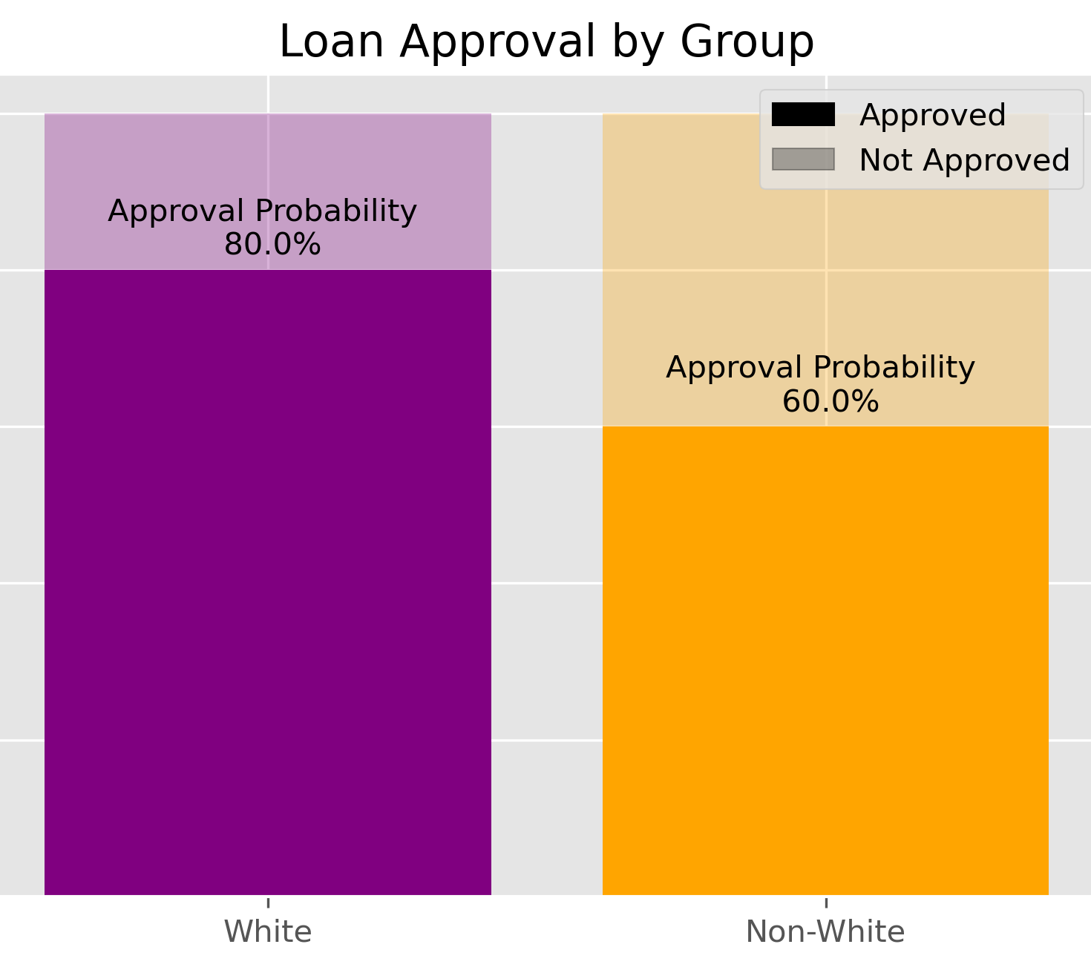
How do we quantify fairness?
Disparate Impact
Measures how much less likely it is for the underprivileged group to receive a positive outcome.
Translation: How much less likely are Non-White applicants to receive approval compared to White applicants?
Notes:
First talk about what we use for dataset. The dataset is for default.
XGBoost - cliens’ preference, commonly used?
Disparate impact - include formula and explain what it is, why is it important
Compare to men, women are more likely to default

Slide 7
How do we quantify fairness?
Disparate Impact
Measures how much less likely it is for the underprivileged group to receive a positive outcome.
Translation: How much less likely are Non-White applicants to receive approval compared to White applicants?
Non-White approval probability
White approval probability
=
60%
= 0.75
80%
Notes:
First talk about what we use for dataset. The dataset is for default.
XGBoost - cliens’ preference, commonly used?
Disparate impact - include formula and explain what it is, why is it important
Compare to men, women are more likely to default

Slide 8
How do we quantify fairness?
Disparate Impact
Measures how much less likely it is for the underprivileged group to receive a positive outcome.
Translation: How much less likely are Non-White applicants to receive approval compared to White applicants?
Non-White approval probability
White approval probability
=
60%
= 75%
80%
Ideal: 100%
Industry Standard: 80%
Notes:
First talk about what we use for dataset. The dataset is for default.
XGBoost - cliens’ preference, commonly used?
Disparate impact - include formula and explain what it is, why is it important
Compare to men, women are more likely to default

Slide 9
A problem…
Disparate Impact
White
Non-White
Does not consider other variables that also impact whether an applicant’s loan gets approved or not
Master’s
Bachelor’s
Doctor
Teacher
$300k
$50k
Notes:
First talk about what we use for dataset. The dataset is for default.
XGBoost - cliens’ preference, commonly used?
Disparate impact - include formula and explain what it is, why is it important
Compare to men, women are more likely to default

Slide 10
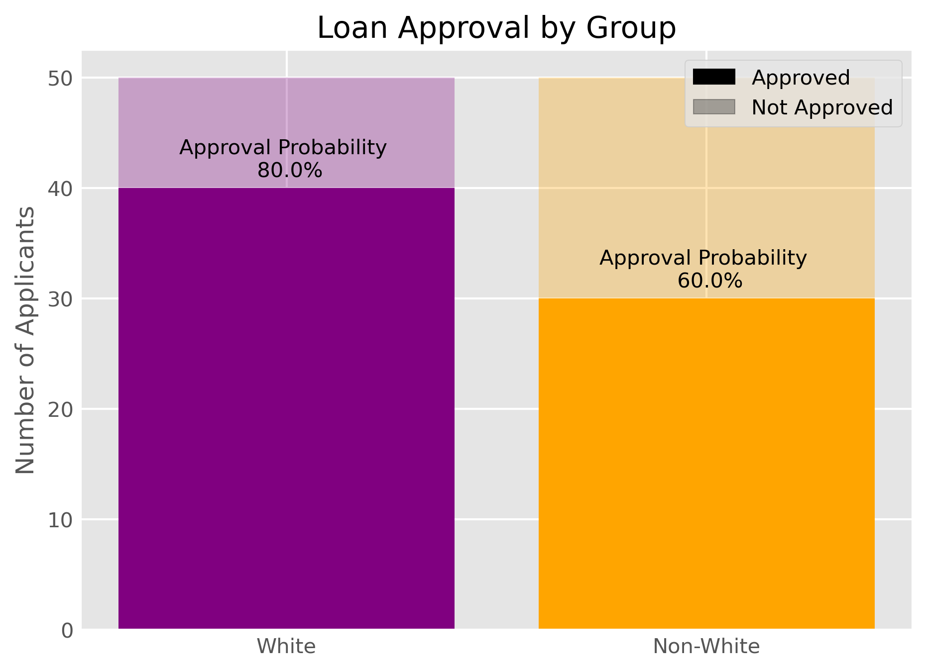
Controlling for Confounding Variables
Hypothetically…
Raw Data: 75% Disparate Impact
Non-White applicants are rejected at a disproportionately higher rate

Slide 11
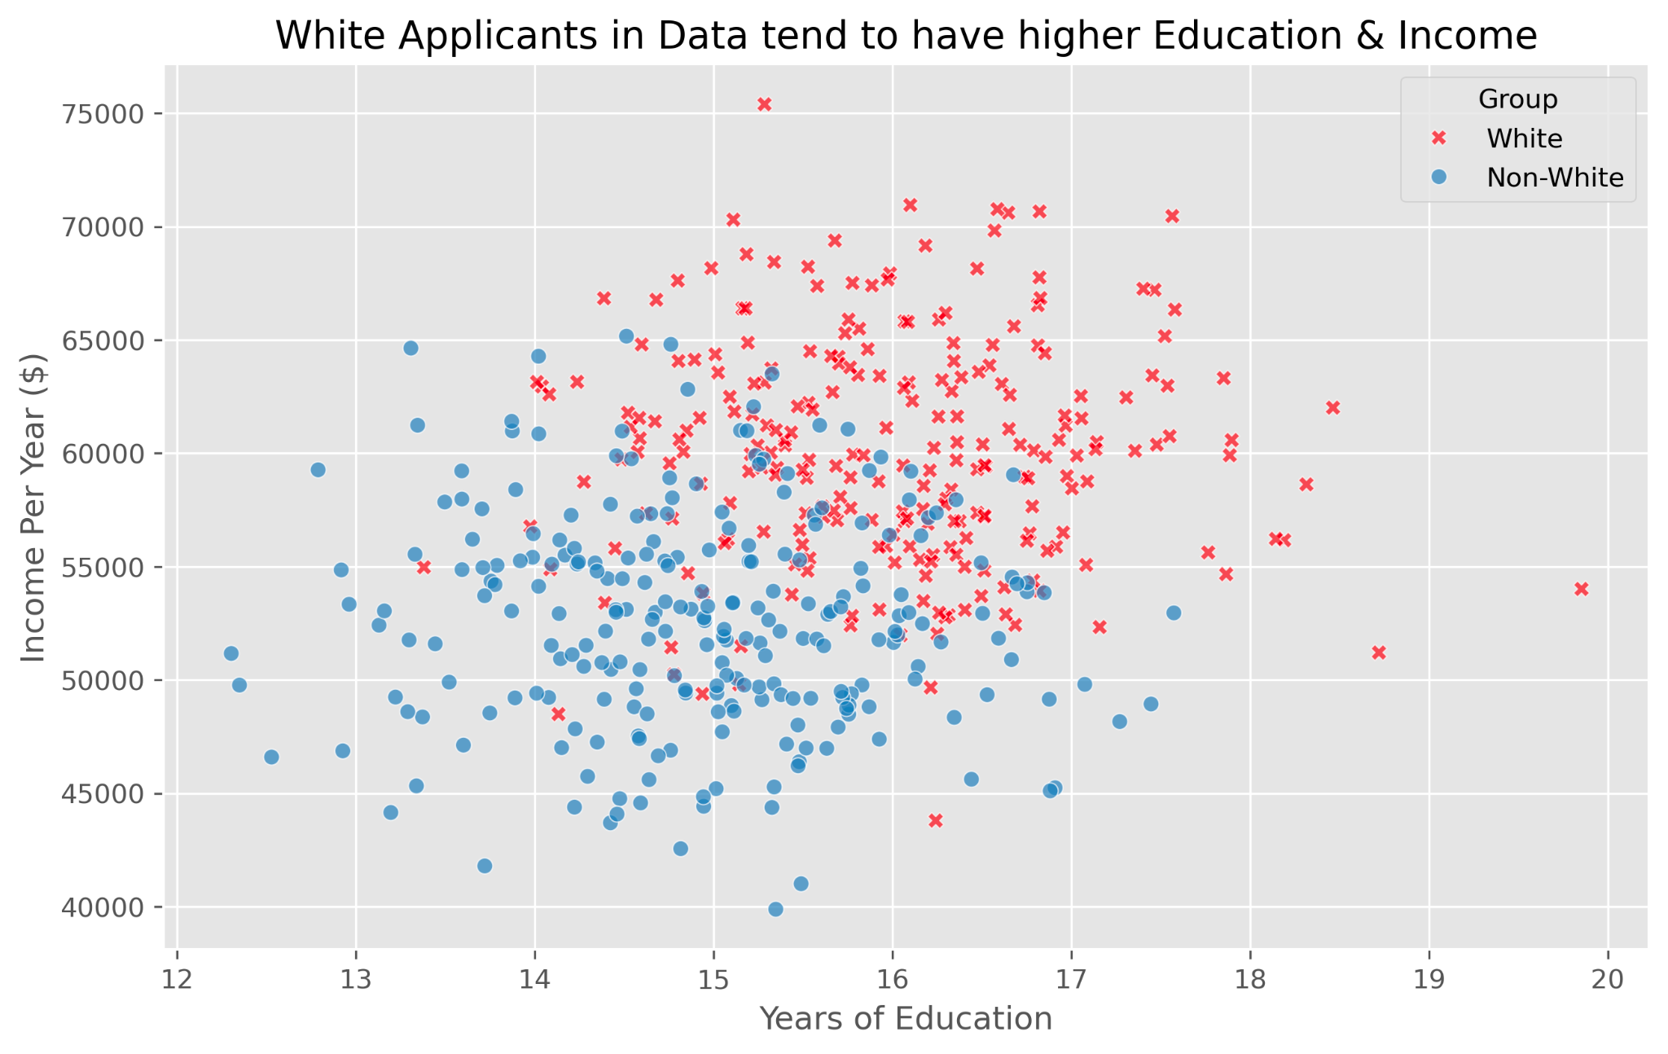
Controlling for Confounding Variables
Behind the scenes:
White applicants in the dataset on average have more years of education and more income than Non-White applicants.
Problem
Banks are allowed to use income and education to decide loan approvals. Meaning that a part of the disparate impact is due to these variables instead of protected attributes, making our original estimate inaccurate.

Slide 12
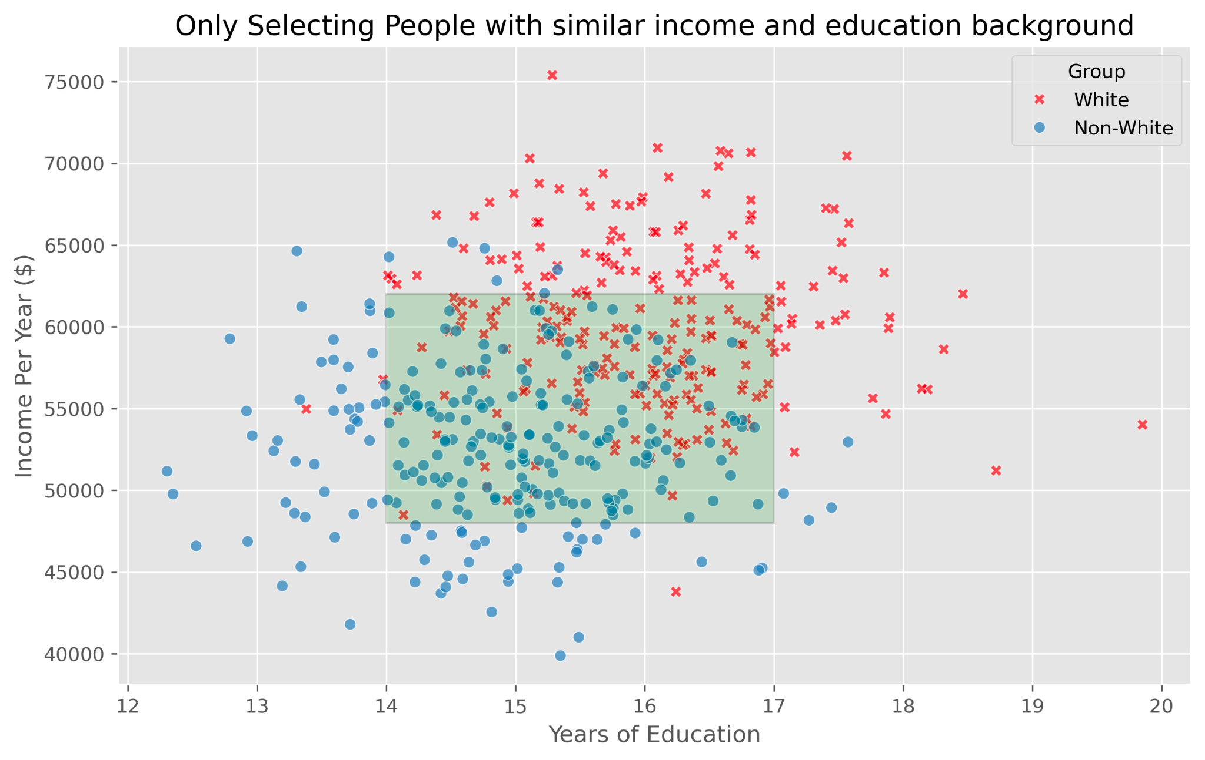
Controlling for Confounding Variables
Solution
Find subset of data where White applicants and Non-White applicants have similar years of education and income.
Technical Solution: Matching Algorithm DAME
Matched Subset

Slide 13
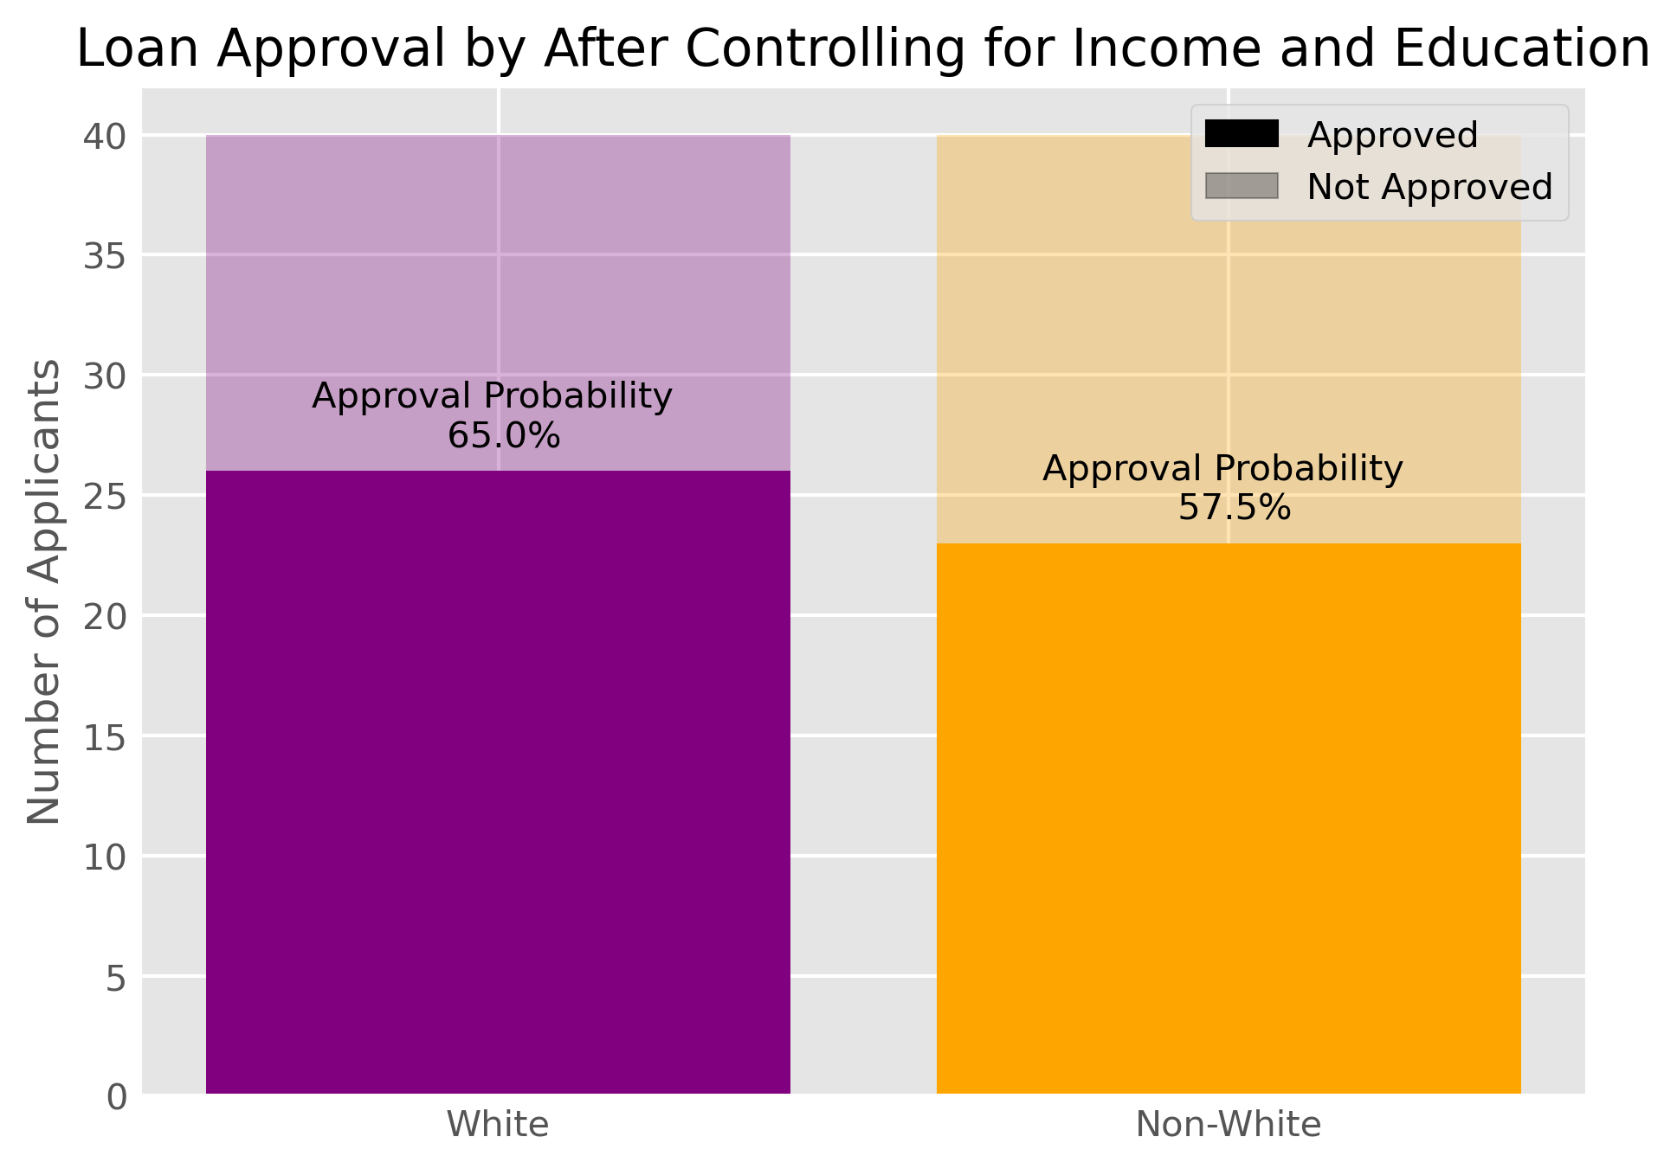
Controlling for Confounding Variables
Recalculate Disparate Impact Using Subset
Matched Data:
75% 88% Disparate Impact
More accurate fairness assessment

Slide 14
Measuring Model Performance
Balanced Accuracy
True Positive Rate: What proportion of bank loans were correctly given out to people who would have paid it
Mean
True Negative Rate: What proportion of bank loans were correctly denied to people who would have defaulted
Notes:
First talk about what we use for dataset. The dataset is for default.
XGBoost - cliens’ preference, commonly used?
Disparate impact - include formula and explain what it is, why is it important
Compare to men, women are more likely to default

Slide 15
Measuring Model Performance
Balanced Accuracy
True Positive Rate: What proportion of banks loans were correctly given out to people who would have paid it.
Gets straight to the point: We want our clients to be able to grant financial products to people who would not default and deny them to people who would.
Ideal for Unbalanced Data: In cases where there are very few defaults in the data, this metric can capture model performance accurately.
Mean
True Negative Rate: What proportion of bank loans were correctly denied to people who would have defaulted
Notes:
First talk about what we use for dataset. The dataset is for default.
XGBoost - cliens’ preference, commonly used?
Disparate impact - include formula and explain what it is, why is it important
Compare to men, women are more likely to default

Slide 16




Overall Methodology
Building an unmitigated model
Build an XGBoost model using raw data that mimics a model our clients would have
Performance Analysis and Comparison
Compare packages performance
Fit Python Packages
Iterate through 10 packages for fairness evaluation and bias mitigation
Fairness Assessment
Evaluate the disparate impact using the package to quantify discrepancies in model predictions
Bias Mitigation
Use techniques in the package to improve disparate impact and reduce bias

Slide 17
Fairness evaluation on adult Dataset
Introduction to the Adult dataset (Census data)
Target variables is whether a person makes above or below 50K a year.
Used as a proxy for default/non-default.
Features : A set of 14 attributes with protected attributes such as race and sex.
Explore any discrimination against, or disadvantages against particular groups of people based on their race, sex, age, or other protected attributes. (fairness evaluation)
Bias present in the dataset:
Disparate Impact on Race Alone: 0.604
Disparate Impact on Sex Alone: 0.363
Disparate Impact on Intersection of Race and Sex: 0.235

Slide 18
Apply Matching to Our Dataset
White adults have 0.38 more years of education on average compared to Non-White adults in the data.
Matching
Disparate Impact Based on Race:
0.60 0.62
0.620
White people work on average 0.38 hours more compared to Non-White people in the data.
Note: The matching process filtered out 27% of White adults and 14% of non-White adults in the data. Also note: The data is from the 1994 census, where systemic barriers prevented and continue to prevent people of color from receiving the same educational and employment opportunities.
0.620

Slide 19
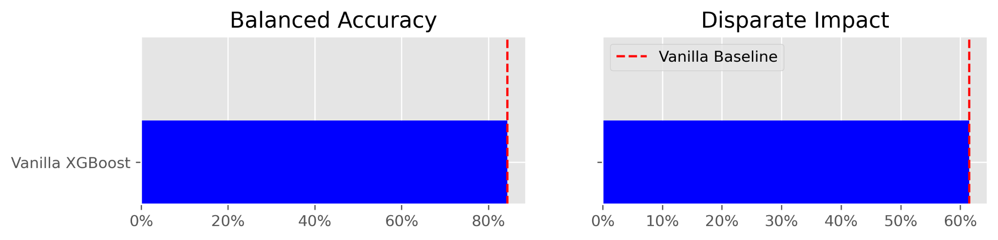
Baseline Model: XGBoost
Bias Accuracy Trade-off
More accurate
More fair
Balanced Accuracy : 84.3%
Disparate Impact on Race: 62%
Privileged Group: White, Unprivileged Group: Non-white

Slide 20



AI Fairness 360
What is AI Fairness 360?
AI Fairness 360 toolkit is an exhaustive open-source library containing techniques developed by the research community to help detect and mitigate bias in machine learning models throughout the AI application lifecycle.
What does it offer?
Comprehensive set of metrics for datasets and models to test for biases.
Explanation of metrics
Pre-processing, In-processing and post processing algorithms to mitigate the bias
Why the AI Fairness 360 toolkit?
Best performance observed out of all the packages in terms of improvement in fairness and reduction in bias.
Ease of usability and generalizability.
Notes:
Talk about the dataset and variable
Show only raw XGBoost first, then compare them to the other methods
Title each one step and isolate the presentation of each step, use color

Slide 21






Pre v. Post-Processing
Pre- processing:
Involve modifying the dataset before training the model to reduce the bias present in the data.
Pre-processing algorithms are useful when the bias in the data is known or can be easily identified.
Post- processing:
Involve modifying the output of the model after it has been trained.
Post-processing algorithms are useful when the model is already trained, and the bias in the predictions is identified after deployment.
Training dataset
Bias Mitigation Pre-processing algorithms
Repaired/Pre-processed
Dataset
Initial Model
Bias Mitigation Post-processing algorithms
Fairer Model

Slide 22
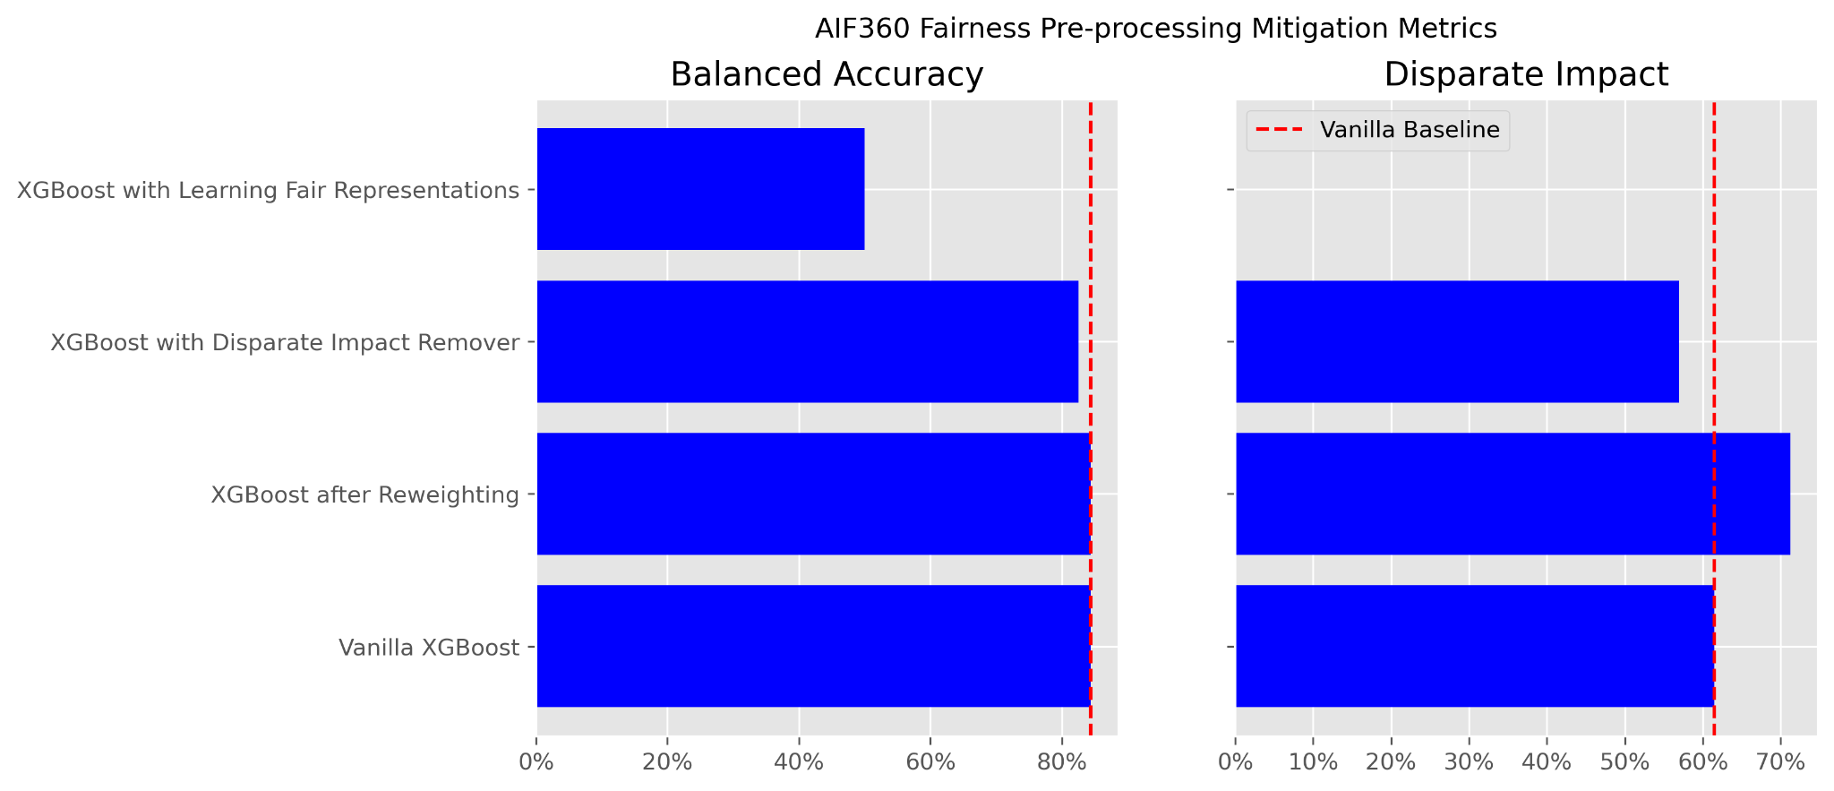
Comparing Different Mitigation Techniques
Pre-Processing
More accurate
More fair
Learning Fair Representation(LFR): Encodes the sensitive attributes to remove association with output variable.
Disparate Impact Remover: Increases group fairness by ensuring balanced representation across protected groups
Reweighting:
Balances training data by adjusting sample weights to reduce bias and enhance fairness
Notes:
Talk about the dataset and variable
Show only raw XGBoost first, then compare them to the other methods
Title each one step and isolate the presentation of each step, use color

Slide 23
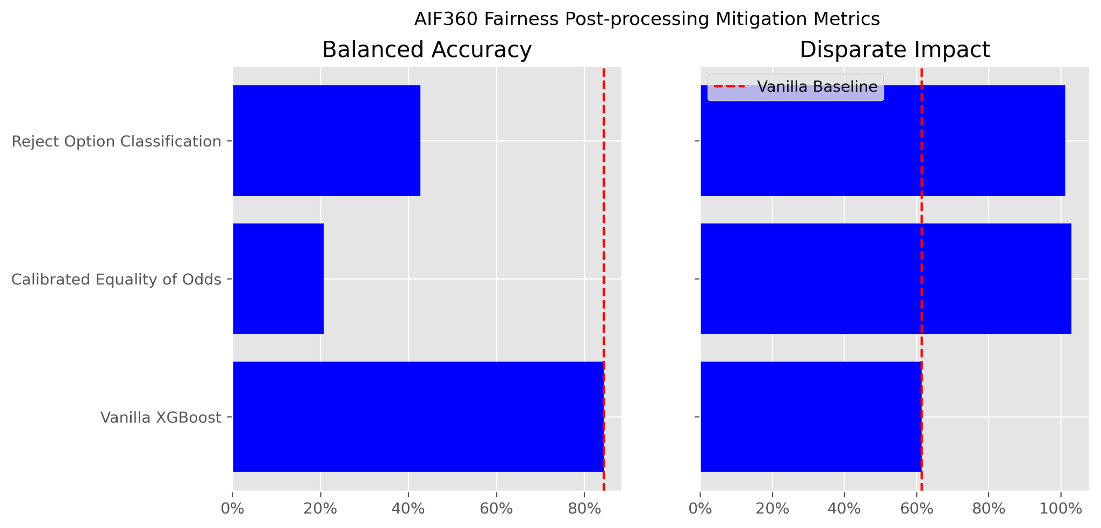
Comparing Different Mitigation Techniques
Post-Processing
More accurate
More fair
Reject option classification:
Rejects more people in the privileged class and accepts more in the unprivileged class
Calibrated equalized odds:
Boosts the unprivileged class and curbs the privileged class to maximize equality of odds

Slide 24
AIF 360: Strengths and Limitations
Strengths:
Comprehensive set of fairness metrics.
Many options of mitigation algorithms.
Manageable degradation in model performance.
Weaknesses:
Needs certain level of literacy in fairness mitigation algorithms.
Lacking in documentation on certain mitigation methods.
Notes:
I added AIF360 before “strengths and weakness” to indicate this slide we’re talking about the package not the whole project

Slide 25







Recommended Fairness pipeline
Pre-processing on training data
Model Training
Model Deployment
Data Cleaning
Data exploration
Feature selection
Matching
Post-processing
on output predictions

Slide 26
What does this project
mean to our clients?
Recommend large toolkit to detect and mitigate bias, especially AIF 360.
Make tradeoffs between bias and accuracy.
Notes:
Leading package but there’s room for improvement on these packages
Can make attempt at correcting shortcomings of that package

Slide 27
Thanks!
Questions?

